Slide 1
Machine Learning
Unsupervised Learning – Self-Organizing Maps
ADF

Slide 2
Outline
Introduction to Self-Organizing Maps
Algorithm
Illustration
Machine Learning

Slide 3
Motivation
Machine Learning

Slide 4
Early philosophical approach
Brain is a self-organizing system that can learn by itself by changing(adding, removing, strengthening) the interconnections between neurons
In the human cortex, multi-dimensional sensory input spaces (e.g., visual input, tactile input) are represented by two-dimensional maps.
The projection from sensory inputs onto such maps is topology conserving.
Machine Learning

Slide 5
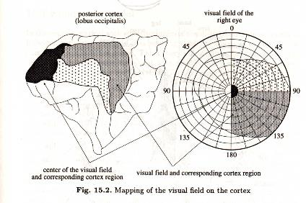
Early philosophical approach
This means that neighboring areas in these maps represent neighboring areas in the sensory input space.
For example, neighboring areas in the sensory cortex are responsible for the arm and hand regions.
Machine Learning

Slide 6
Self-organizing Maps
Unsupervised learning neural network
Introduced by Prof. Teuvo Kohonen in 1982
Also known as Kohonen feature map
Maps multidimensional data onto a 2 dimensional grid
Machine Learning

Slide 7
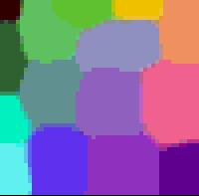
Self-organizing Maps
Geometric relationships between image points indicate similarity
Clustering tool of high-dimensional and complex data
Maintains the topology of the dataset
Can be used for detecting similarity and degrees of similarity
Machine Learning

Slide 8
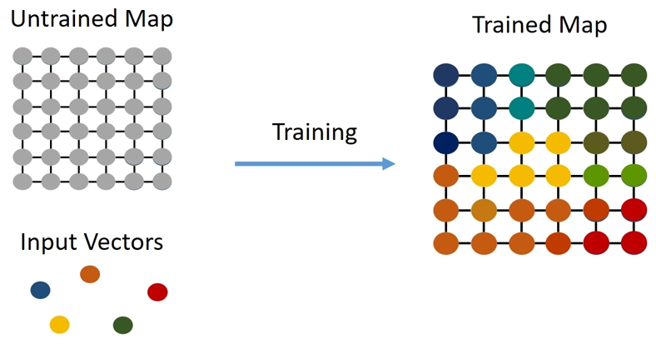
Self-organizing Maps
Machine Learning

Slide 9
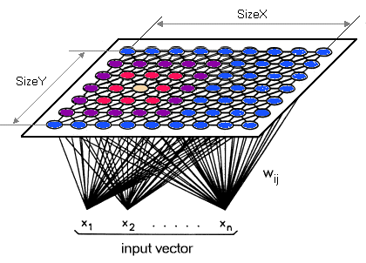
Self-organizing Maps
Machine Learning

Slide 10
SOM Network
Machine Learning

Slide 11
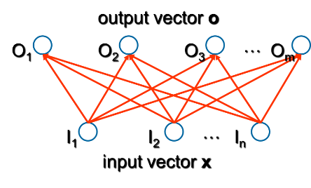
Self-organizing Maps
Two layers: input layer and output (map) layer
Input and output layers are completely connected.
Output neurons are interconnected within a defined neighborhood.
(hidden) competitive/topology layer
Machine Learning

Slide 12
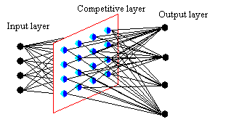
Self-organizing Maps
A topology (neighborhood relation) is defined on the output layer
Machine Learning

Slide 13
Self-organizing Maps
Neurons arranged in a 2 dimensional grid
Each neuron contains a weight vector and permanent location
Training occurs via competition between the neurons
Random weight vector initialization
Impossible to assign network nodes to specific input classes in advance
Machine Learning

Slide 14
SOM - Input Layer
Accepts multidimensional input pattern from the environment
An input pattern is represented by a vector.
e.g. a sound may consist of pitch, timbre, background noise, intensity, etc.
Each neuron in the input layer represents one dimension of the input pattern
An input neuron distributes its assigned element of the input vector to the competitive layer.
Machine Learning

Slide 15
SOM - Output Layer
Each neuron in the topology map receives a sum of weighted inputs from the input layer
Every neuron in the topology map is associated with a collection of other neuron which make up its ‘neighborhood’
Machine Learning

Slide 16
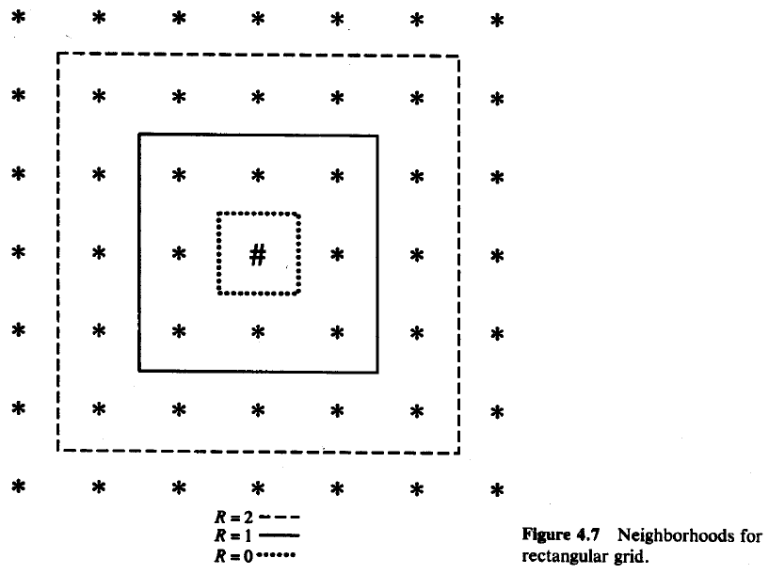
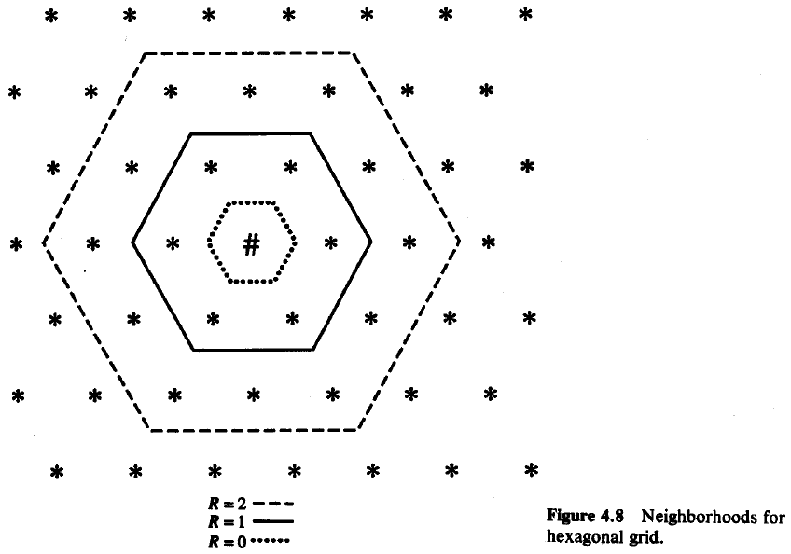

SOM - Output Layer
Topology map can be organized in 1 or 2 dimensions (typical implementations).
Each grid point represents a output node
The grid is initialized with random vectors
Machine Learning

Slide 17
SOM – Common Output Layer Structures
One-dimensional (completely interconnected for determining “winner” unit)
i
Machine Learning

Slide 18
SOM – Common Output Layer Structures
Two-dimensional (connections omitted, only neighborhood relations shown by the green edge)
i
Machine Learning

Slide 19

SOM – Neighborhood Function
A neighborhood function $φ\left(i,k\right)$ indicates how closely neurons $i$ and $k$ in the output layer are connected to each other.
Usually, a Gaussian function or Lateral Feedback on the distance between the two neurons in the layer is used:

Machine Learning

Slide 20
SOM Algorithm
Machine Learning

Slide 21
Components of Self-Organization
Initialization
Competition
Cooperation
Adaptation
Machine Learning

Slide 22
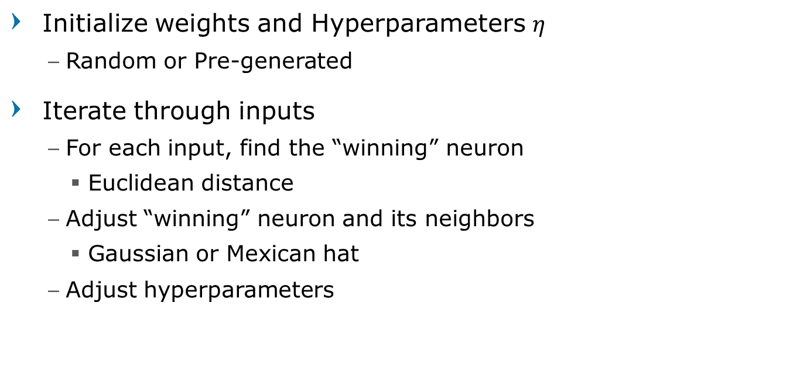
SOM – Algorithm Simplified
Initialize weights and Hyperparameters $η$
Random or Pre-generated
Iterate through inputs
For each input, find the “winning” neuron
Euclidean distance
Adjust “winning” neuron and its neighbors
Gaussian or Mexican hat
Adjust hyperparameters
Machine Learning

Slide 23

SOM – Algorithm Detailed (1)
Input : $i=1..n$
Neuron : $j=1..m$
Initialize weights $w_{j}$
Can be generated using PCA
Set learning rate $η$
Set neighborhood function $φ$
Machine Learning

Slide 24
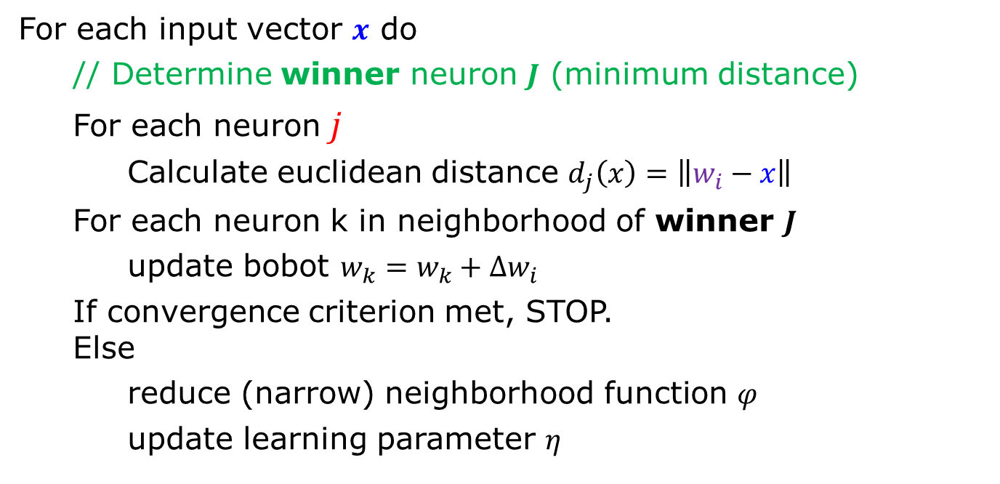
SOM – Algorithm Detailed (2)
For each input vector $x$ do
// Determine winner neuron $J$ (minimum distance)
For each neuron$j$
Calculate euclidean distance $d_{j}\left(x\right)=\left\|w_{i}−x\right\|$
For each neuron k in neighborhood of winner $J$
update bobot $w_{k}=w_{k}+Δw_{i}$
If convergence criterion met, STOP. Else
reduce (narrow) neighborhood function $φ$
update learning parameter $η$
Machine Learning

Slide 25

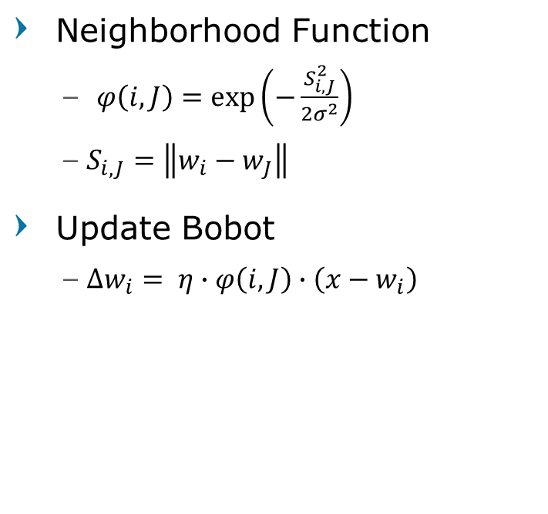
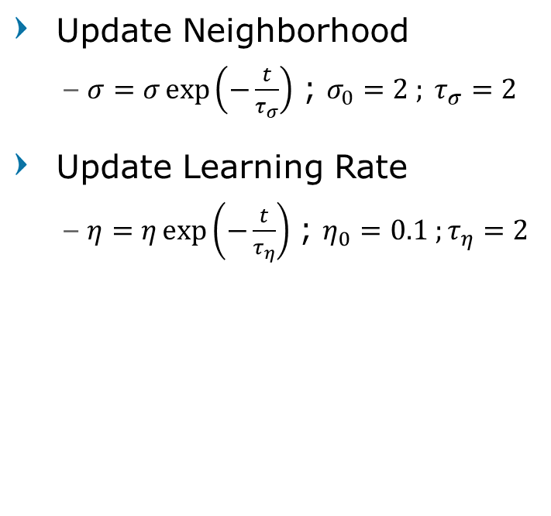
SOM – Algorithm Detailed (3)
Neighborhood Function
$φ\left(i,J\right)=\exp\left(−\frac{S_{i,J}^{2}}{2σ^{2}}\right)$
$S_{i,J}=\left\|w_{i}−w_{J}\right\|$
Update Bobot
$Δw_{i}= η∙φ\left(i,J\right)∙\left(x−w_{i}\right)$
Update Neighborhood
$σ=σ\exp\left(−\frac{t}{τ_{σ}}\right)$ ; $σ_{0}=2 ; τ_{σ}=2$
Update Learning Rate
$η=η\exp\left(−\frac{t}{τ_{η}}\right)$ ; $η_{0}=0.1 ;τ_{η}=2$
Machine Learning

Slide 26
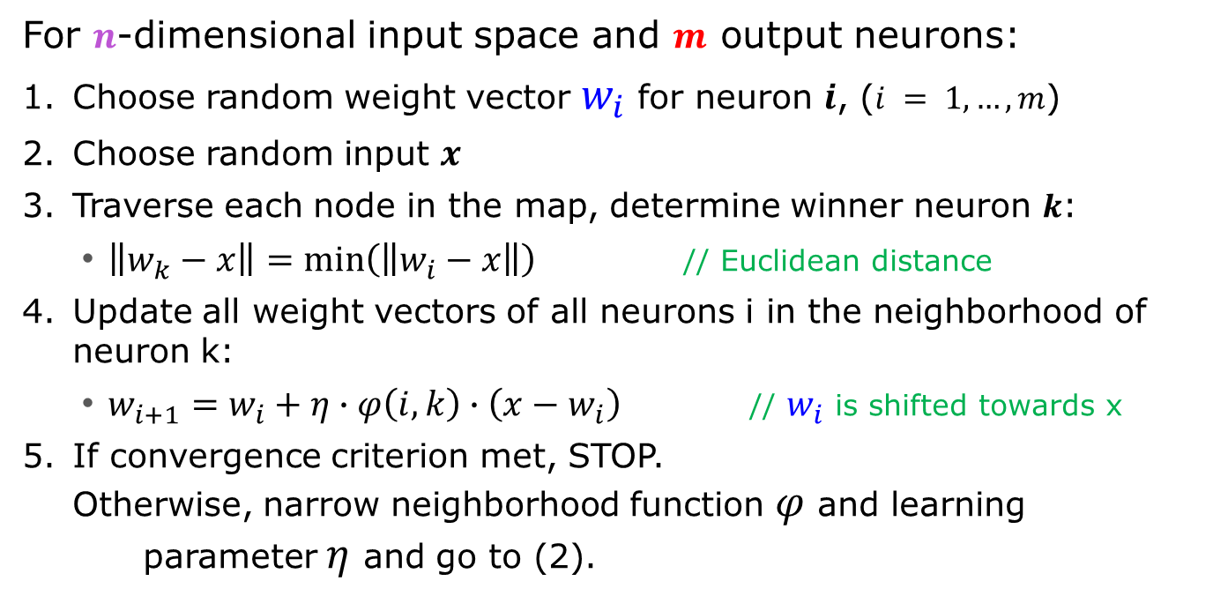
SOM – Algorithm (Alt)
For $n$-dimensional input space and $m$ output neurons:
Choose random weight vector $w_{i}$ for neuron $i$, ($i = 1, …, m$)
Choose random input $x$
Traverse each node in the map, determine winner neuron $k$:
$\left\|w_{k}−x\right\|=\min\left(\left\|w_{i}−x\right\|\right)$ // Euclidean distance
Update all weight vectors of all neurons i in the neighborhood of neuron k:
$w_{i+1}=w_{i}+η∙φ\left(i,k\right)∙\left(x−w_{i}\right)$ // $w_{i}$ is shifted towards x
If convergence criterion met, STOP. Otherwise, narrow neighborhood function $φ$ and learning parameter $η$ and go to (2).
Machine Learning

Slide 27
SOM Algorithm Illustration
Machine Learning

Slide 28
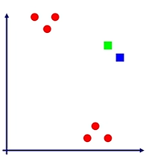
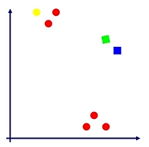
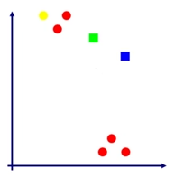
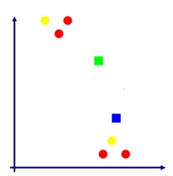
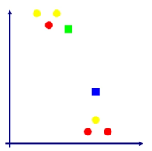
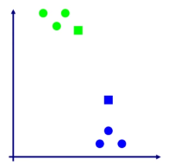

SOM – Illustration (1D)
Machine Learning

Slide 29
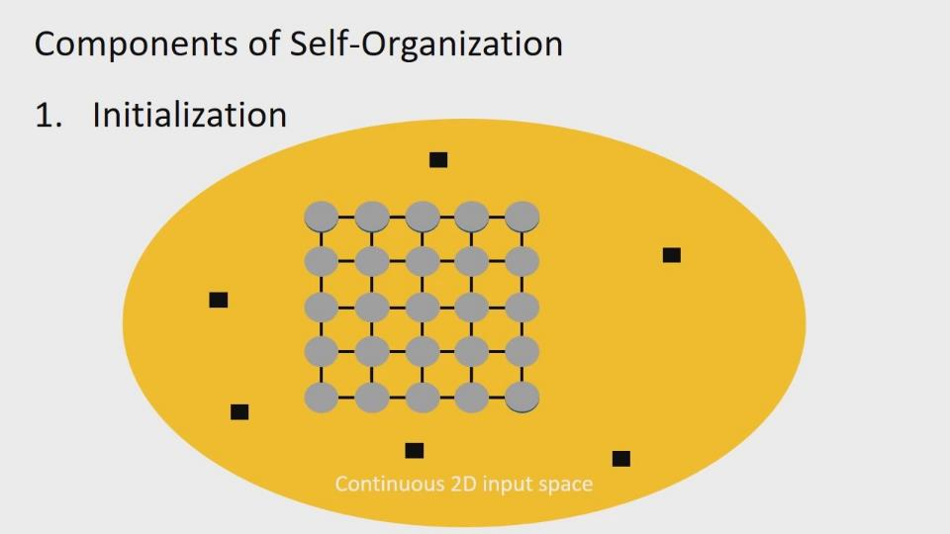
Machine Learning

Slide 30
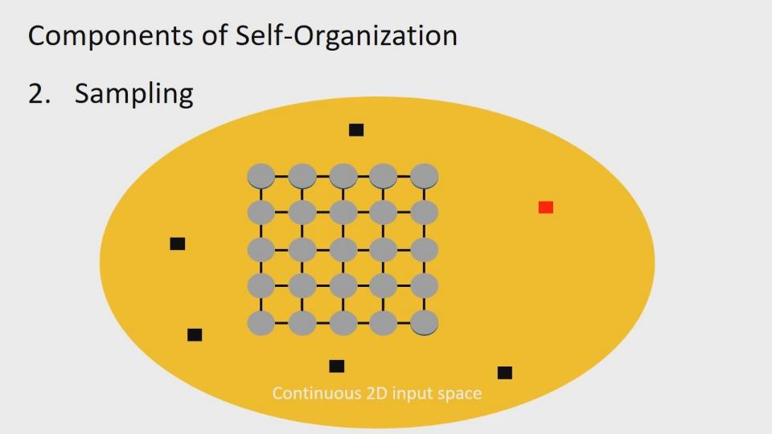
Machine Learning

Slide 31
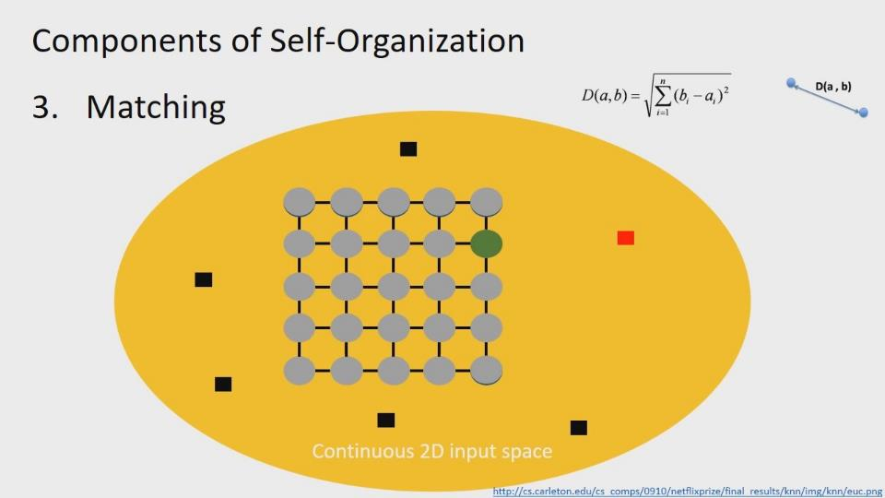
Machine Learning

Slide 32
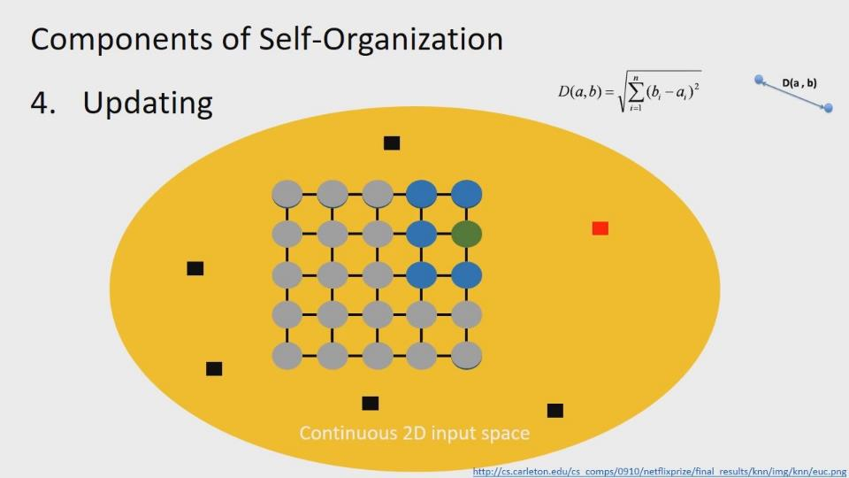
Machine Learning

Slide 33
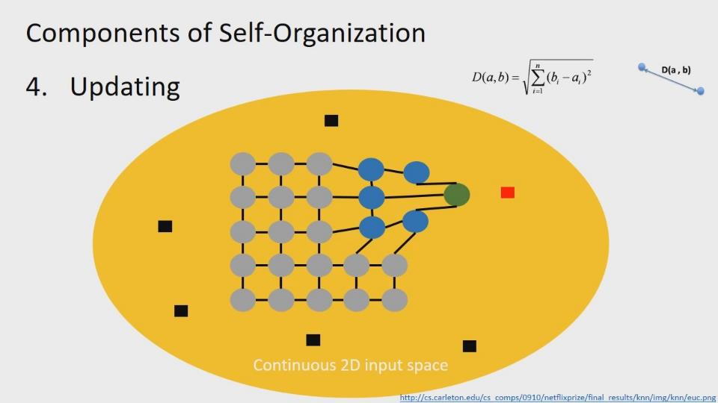
Machine Learning

Slide 34
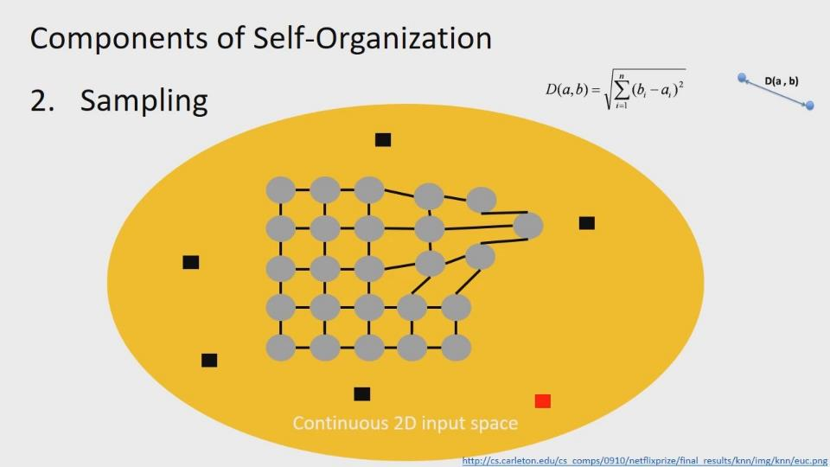
Machine Learning

Slide 35
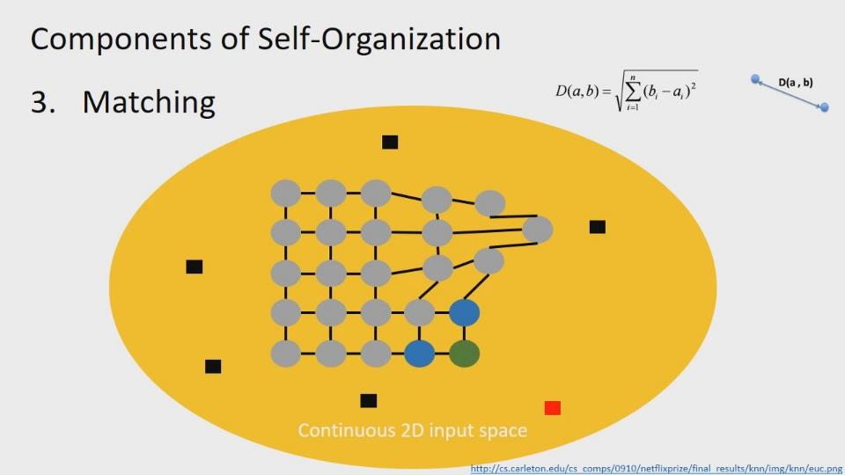
Machine Learning

Slide 36
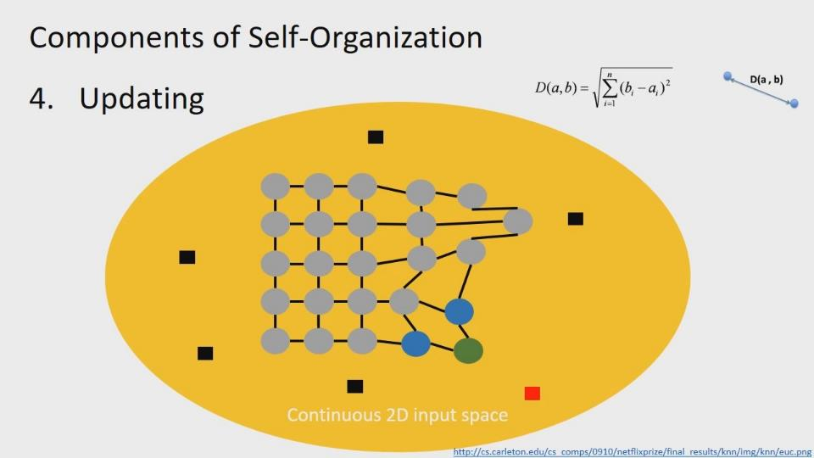
Machine Learning

Slide 37
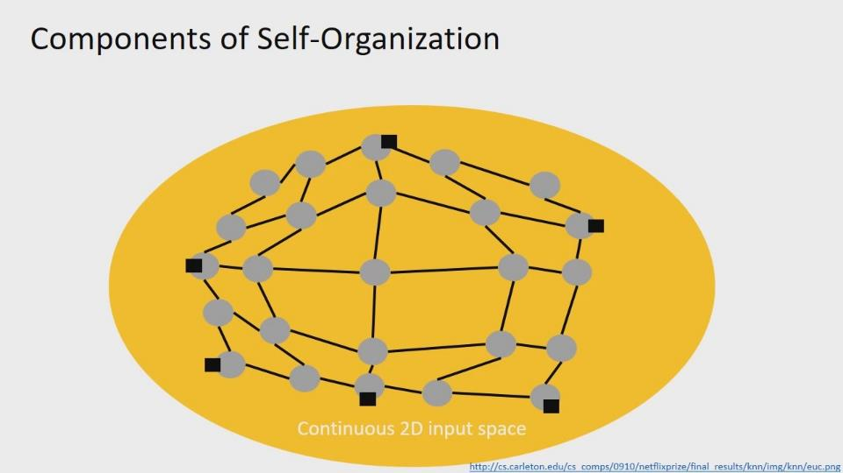
Machine Learning

Slide 38
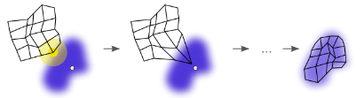
SOM – Illustration
Machine Learning

Slide 39
Self-Organizing Maps Pros and Cons
Machine Learning

Slide 40
Computationally Very Expensive
Good Initialization Pre-generating neuron weights
Less iterations
Quality of Map (Initialize map closer to final state)
Reducing input / neuron dimensionality
Random Projection method
Restricting “winning” neuron search
Reduce the amount of exhaustive searches
Nearest neighbor, Farthest neighbor
Distance between means
Distance between medians
Machine Learning

Slide 41
SOM – Pros and Cons
Advantages
Data mapping is easily interpreted
Capable of organizing large, complex data sets
Disadvantages
Difficult to determine what input weights to use
Mapping can result in divided clusters
Requires that nearby points behave similarly
every SOM is different
Machine Learning

Slide 42
Question?
Machine Learning

Slide 43
Machine Learning

